Slide 1
Denominators Team Project Updates
Roma Bhatkoti & Joshua Davis
November 2019

Slide 2
Agenda
Denominator 3 - Population DREAMS update – Roma
Denominator 1 - VMMC Presentation and discussion– Stephanie/Carlos
Denominator 2 - KP population presentation and discussion – Roma/Mala
YODA update – Ian/Ray
Denominator 4 – PLHIV - DATIM and NAOMI alignment process – Roma/Josh/Scott
Notes:
UNAIDS Reference Group on Estimates, Modelling and Projections

Slide 3
Denominator 3 - Population DREAMS update

Slide 4
Background
What is DREAMS program completion and DREAMS saturation.
Program completion addresses when DREAMS as a package of comprehensive interventions can be considered complete at the individual level.
Saturation addresses how a country team can document that DREAMS has saturated at the SNU level among all relevant age groups of AGYW.
DREAMS is still a new program. However, as it evolves, we want to see DREAMS implemented in more SNUs to maximize the benefit of the program and ensure all relevant AGYW have been reached.
To reach that goal, we need to assess progress in current SNUs to understand when to redirect resources to new SNUs while continuing to meet the needs of vulnerable AGYW in the original SNUs.
To calculate saturation of DREAMS at the SNU level, we need to estimate the number of AGYW in each DREAMS SNU
Saturation can be used to determine if and where DREAMS need to be expanded in COP20.

Slide 5
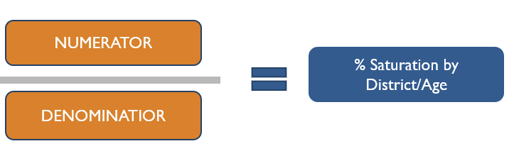
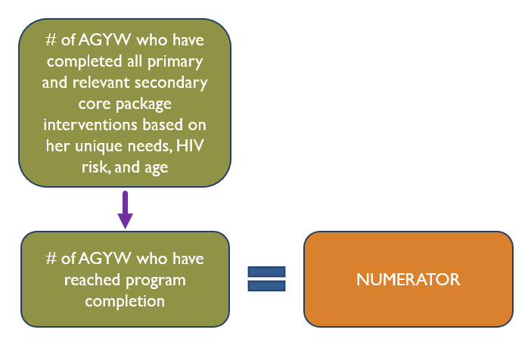
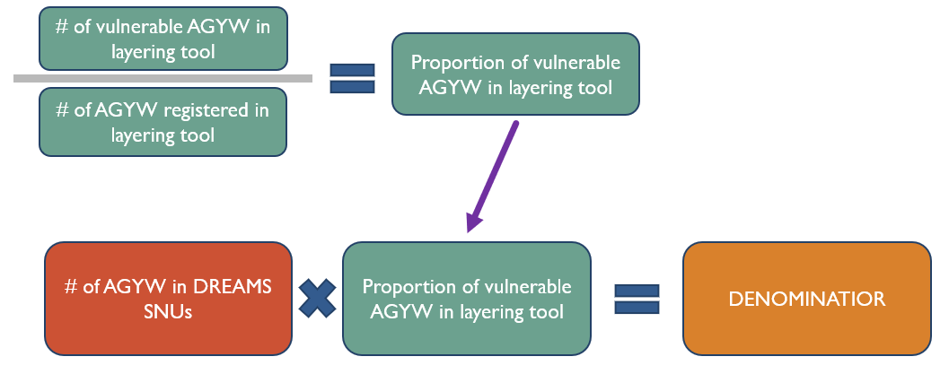

Slide 6
Population DREAMS update
Primary source subnational population – actual census counts published by the various countries
Issues with using census counts for PLHIV estimation
frequency
data gaps
reliability
Solution – provide population alternatives to census counts for countries.

Slide 7
Population Source Available
Potential Population Sources
WorldPop - https://www.worldpop.org/
LandScan - https://landscan.ornl.gov/
Facebook - https://data.humdata.org/organization/facebook
Gridded Population of the World (GPW) - https://sedac.ciesin.columbia.edu/data/collection/gpw-v4
GHS POP - https://ghsl.jrc.ec.europa.eu/ghs_pop2019.php
Global Rural-Urban Mapping Project (GRUMP) - https://sedac.ciesin.columbia.edu/data/collection/grump-v1
ArcGIS Living Atlas of the World - https://livingatlas.arcgis.com/en/browse/#d=2&q=World%20Population%20Estimate
US Census Subnational Population by Sex, Age, and Geographic Area - https://www.census.gov/geographies/mapping-files/time-series/demo/international-programs/subnationalpopulation.html

Slide 8
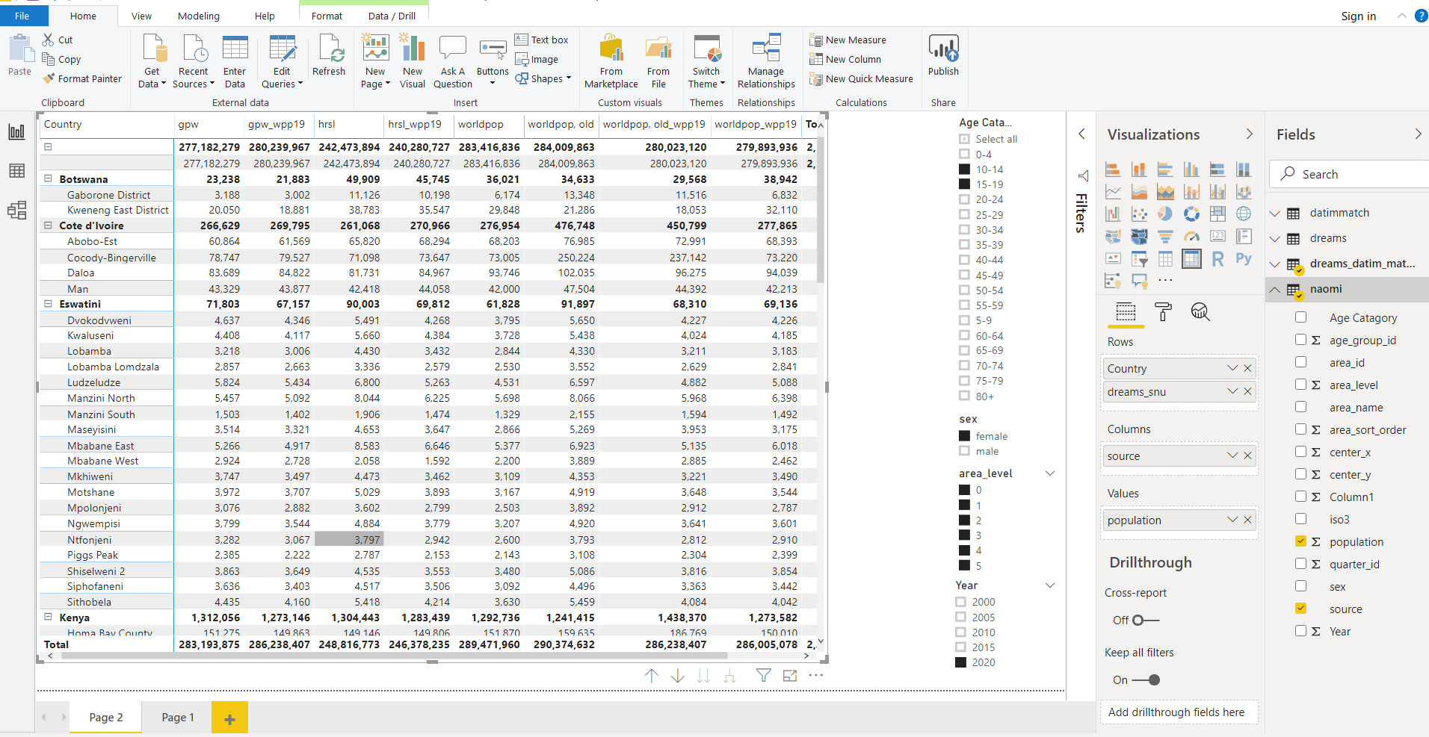
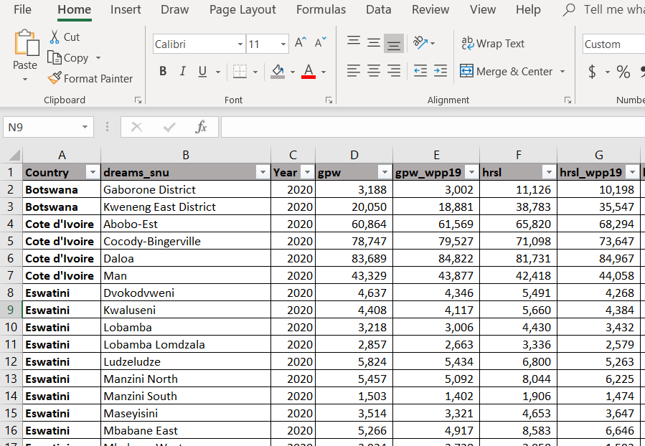
Age and Sex population disaggregates
Age and Sex disaggregates also being used for PLHIV estimation in NAOMI model
Use the same disaggregate for DREAMS SNUs.
EXCEL file with DREAMS SNU population AGYW estimates
Power BI dashboard population estimates
Notes:
Population Source Model
Method - Using Rasterized Population Data
Connect to the publically available population database such as WorldPop, a High spatial resolution, contemporary data on human population.
Use publically available R packages to gather iso3 names (identifiers for countries) for PEPFAR countries from WorldPop FTP.
Developed R script to download individual (PEPFAR) countries population raster datasets for the most recent years from WorldPop FTP.
Download PEPFAR subnational shape files from ArcGIS online.
Developed R script to run zonal statistics for PEPFAR subnational units (which means calculating subnational population for PEPFAR countries).
This method is generalizable for all population data available in rasterized form.
Import the subnational populations into PAW.

Slide 9
What next
Review sources to recommend best ‘default’ source for population inputs by SNU2 / age / sex.
Be able to provide countries with documentation for basic methodologies and specific data sources that were used for population inputs (e.g. which censuses, at what level of stratification.)
Record any country-specific challenges or discrepancies that should be considered by country teams when creating their estimates.
Notes:
Population Source Model
Method - Using Rasterized Population Data
Connect to the publically available population database such as WorldPop, a High spatial resolution, contemporary data on human population.
Use publically available R packages to gather iso3 names (identifiers for countries) for PEPFAR countries from WorldPop FTP.
Developed R script to download individual (PEPFAR) countries population raster datasets for the most recent years from WorldPop FTP.
Download PEPFAR subnational shape files from ArcGIS online.
Developed R script to run zonal statistics for PEPFAR subnational units (which means calculating subnational population for PEPFAR countries).
This method is generalizable for all population data available in rasterized form.
Import the subnational populations into PAW.

Slide 10
Denominator 1 - VMMC Presentation and discussion Proposal for creating a running interagency measure of male circumcision coverage

Slide 11
Problem Statement
PEPFAR has supported over 20 million VMMCs, with current annual investments around $285 million
PEPFAR currently prioritizes achieving 80-90% coverage among males 15-29 years in priority districts
Efficient annual program planning and resource use therefore requires reliable measures of current coverage on the national and subnational (district) levels
These do not exist. Current modeled estimates, datapack estimates and survey estimates are all unusable.
Modeled (DMPPT2) and survey coverage estimates for the same year and group sometimes disagree profoundly
DMPPT2 filled a gap and has given PEPFAR experience with processes for determining coverage, but we now need a revised process which cross-harmonizes
PHIA data is powered for provincial-level coverage, and even 2-3-year-old data is outdated because coverage in some areas increases quickly

Slide 12
Case study: Uganda
 | eSwatini, Aug 2016-March 2017 | Lesotho, Nov 2016-May 2017 | Malawi, Nov 2015- Aug 2016 | Namibia, June-Dec 2017 | Tanzania, Oct 2016- Aug 2017 | Uganda, Aug 2016-Mar 2017 | Zambia, March-Aug 2016 | Zimbabwe, Oct 2015-Aug 2016
DMPPT2 15-29 MC coverage | 29 (28 – 30) | 41 (37 – 44) | 21 (19 – 22) | 35 (33 – 38) | 79 (78 – 80) | 55 (51 – 59) | (no DMPPT2 model) | 23 (22 – 25)
PHIA 15-29 medical only MC coverage | 33 (30-35) | 46 (43-49) | 12 (10-13) | 28 (25-30) | 57 (54-59) | 27 (25-29) | 26 (25-28) | 17 (16-19)
PHIA 15-29 nonmedical MC coverage | 1 (0-1) | 23 (21-25) | 14 (13-16) | 12 (10-16) | 23 (21-25) | 19 (17-20) | 5 (4-6) | 1 (1-2)
Is DMPPT2 between PHIA medical and PHIA all MC? | No, but uncertainties (nearly) overlap | No, but uncertainties overlap when nonmedical coverage excluded | yes | yes | No, but uncertainties overlap when nonmedical coverage included | No; uncertainties do not overlap; value is closest to PHIA all MC coverage | N/A | No; uncertainties do not overlap; value is closest to PHIA all MC coverage
Coverage: 55% vs 46% national-level coverage in DMPPT2 vs PHIA estimates for 2016-2017
Does not include subnational-level variations
Achievement inputs: Total VMMCs performed 2012-2017 = 2.2 million in DMPPT2 inputs, vs. 4.0 million in WHO estimates and 3.6 million reported by PEPFAR alone (DMPPT2 total MCs across 14 MC countries nearly 1.3 million below PEPFAR)
This level of uncertainty exists in a country that gets nearly $36 million annually in PEPFAR VMMC funding
How long will this be needed? Is it still needed?
Uganda is a successful VMMC country – should it get more money to finish faster and free up future resources?

Slide 13
Problem statement – cont’d
In addition to being inconsistent, existing estimates have overlapping processes and functions
Populating VMMC_CIRC_NAT and VMMC_TOTALCIRC_NAT_MER requires the same input data as annually updating DMPPT2, but processes have been separate and values are not cross-harmonized
PEPFAR and WHO annual achievement estimates are cross-harmonized with each other but not DMPPT2
Datapack is populated and updated by countries - may use any or none of these sources
A sustainable process needs to be housed somewhere sustainable – e.g. ICPI would be preferable to an implementing partner

Slide 14
Objective
A unified interagency, validated, cross-harmonized, and regularly updated coverage estimation process used to populate all planning tools is needed
Specific process
Still to be defined, but could have similarities to one or more existing processes
Needed inputs would include (source may vary between countries):
Baseline coverage estimates - harmonized with latest PHIA data, but more granular
Annual VMMCs achieved by age
Population age structure and distribution of VMMC achievements
Ideally, redefining VMMC_TOTALCIRC_NAT as a coverage indicator would give national-level estimates a widely accessible ‘home’

Slide 15
Outline of steps for developing objective
Review currently available primary data sources (PEPFAR indicators, PHIA, MoH reporting, others) and existing approaches/estimates (datapack, DMPPT2, others) to identify limitations, gaps and inconsistencies
Identify standardized data elements and a verification process
Details in proposal
Inputs need to be harmonized with MoH, PEPFAR and WHO/UNAIDS data
Develop the tool Propose associated changes to the datapack process and PEPFAR MER indicators
Timeline: start process ASAP, complete in time for COP21 process

Slide 16
Deliverables
Validated, harmonized tool providing age-specific national and district-level MC coverage estimation, directly accessible by PEPFAR HQ and field offices
Comparison table of data sources, variables collected, definitions used, process for verification
Summary document on how the tool internal process is similar to and different from previous sources for coverage estimates
Agreed-on process and roles for incorporating available data streams to update tool at least annually
Recommendations to changes to datapack process and PEPFAR MER Indicators to inform COP20 and future reporting

Slide 17
Denominator 2 - KP population presentation and discussion

Slide 18
Background
CDC and USAID KP Team working with John Hopkins to develop KP Atlas.
A comprehensive systematic literature review has been conducted to identify and list KP studies based on inclusion and exclusion criteria.
John Hopkins working on methodology for quantifying key population sizes at the subnational level.
While, survey based direct estimates of key populations are available in a few urban centers, no data on key population size exists in areas without sufficient infrastructure.
John Hopkins Approach
Bayesian regression approach to produce estimates of MSM in areas of Côte d’Ivoire by imputing missing covariates using geo-spatial information that allows for uncertainty quantification leading to confidence bounds for predicted MSM population size estimates.
This process provided population size estimate where there are no empirical data.
Planned Activity
Promoting the use of KP denominator data in other analyses by incorporating them in planned platforms like PAW, shiny apps and other products from our workstream – Currently Under Progress
Using these estimates as one source, together with other estimates, program data, and other relevant data sources, in order to get even better KP denominators (i.e. KP living with HIV) for program planning. For example, we may have a rigorously conducted survey that is over 5 years old but can we use modeling such as SAE or other approaches to bring in more recent population data and/or more recent program data that allows us to update that old estimate.
Collaborating with John Hopkins for SAE approach…?

Slide 19
Global HIV data repository summary USAID/Johns Hopkins University November, 12, 2019

Slide 20
Repository Inclusion criteria
Studies of any design from all countries and settings with data among key population (even if these groups are not the main focus of the study), capturing burden and risk of HIV, including:
Prevalence, incidence, prevention and treatment cascade
Population size estimates
Experienced violence and engagement with healthcare systems
Participants in studies can be of any age, race, or ethnicity
Published between January 1, 2006 and January 1, 2019
Data must be from one of the following:
published in a peer-reviewed journal
presented as an abstract at a scientific conference
available on the web from governmental or non-governmental sources
submitted to UNAIDS via Global Aids Monitoring (GAM) system or to the CDC database
Qualitative studies and modeling studies are included as searchable records in the data repository, but qualitative data is not abstracted or included in the quantitative narrative analysis.

Slide 21
Repository Exclusion criteria
Studies where sample size was less than 50
Studies published in languages other than English, French, or Spanish

Slide 22
Repository records (1 record per data source*)
Sources from CDC
# records (%) key population library
1059 (26%) FSW
1186 (28%) MSM
251 (6%) Transgender persons
292 (7%) Incarcerated
1351 (32%) PWUD
________________________
4139 (100%)
233 HIV-related data points from CDC already present in repository
133 additional sources from CDC added to repository
*Sources reporting on multiple key populations will report data for each KP as a separate record in each key population library

Slide 23
Repository PSE data: reported methods breakdown
14% Service multiplier
5% Unique object multiplier
14% Capture-recapture
31% Mapping and enumeration
34% Other (Literature review, Delphi, Wisdom of the crowds, other methods)

Slide 24
Current exercise
Objective: To work with a dataset of Key Populations Estimates studies across PEPFAR countries conducted from 2014-2019
Goal: a machine readable data set of CDC accepted studies of robust methodology that provide estimates for at least one of the five WHO defined Key Populations (FSW, MSM, TG, PWID, Prisoners)

Slide 25
Current exercise
Step 1: Defined which exclusions to implement
Step 2: Performed the following exclusions
We excluded:
-Non-PEPFAR countries
-Studies with data collection before 2014
-Studies in general population or a non-WHO Key Pop
-Studies with non-robust methodologies
Step 3: Assign PEPFAR validated geographic data as needed
Step 4: Split up studies from multiple geographic locations as needed

Slide 26
Current exercise
Robust Methodologies
-Multiplier
Excluded Methodologies (per CDC guidelines)
-Census
-Mapping
-Extrapolation

Slide 27
Current exercise
Next Steps
Complete all exclusion steps & geographic data population
Confirm data completeness
Handoff to stakeholders for:
-Incorporation into Panorama Dossiers, Shiny apps, & other products
-Use in datasets for better Key Pop denominators for program planning

Slide 28
Yoda Update
Ian E. Fellows

Slide 29
YODA: Refresher
Historical Yield Rates
Spectrum Data
Proposed HTS_TST Allocation
Yield Model
Estimated Yield
Greedy Optimizer
Yield Model
Generalized Linear Mixed Model
Gradient Boosted Machine
Elastic Net
Final HTS_TST

Slide 30
YODA: Yield Model Improvements
Site Long / Lat Coordinate Extraction
Hierarchical Spatial Partitioning
Small Area Prevalence Measure from PMTCT
Local Population Size Estimates From WorldPop

Slide 31
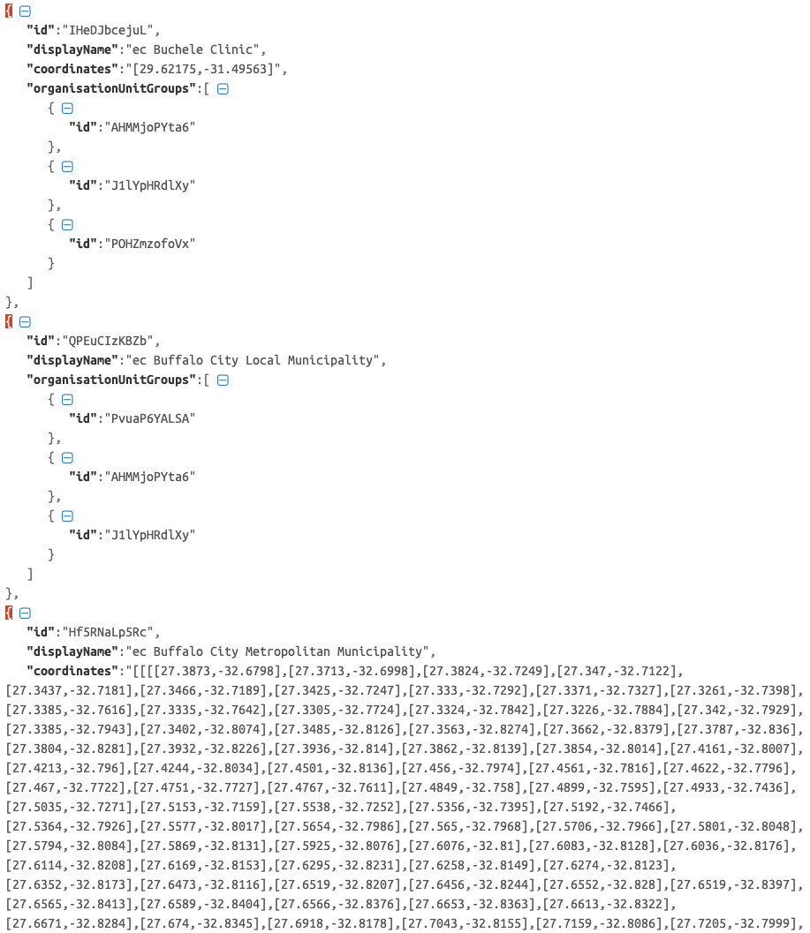
YODA: Site Long/Lat Coordinates
Pull all location data for a country.
If the location is an area, calculate its centroid
Assign locations to each site with the following fallbacks:
If the site has coordinates, use them.
Otherwise, use its community’s coordinates if they exists.
Finally fall back to PSNU coordinates.
DATIM API Example

Slide 32
YODA: Hierarchical Spatial Partition
Recursively divide the country into increasingly small rectangles with division lines alternating between the median latitude and longitude of the parent rectangle.
Benefits:
All partitions have approximately the same number of sites
Higher fidelity in areas with more information (cities) lower fidelity in more sparse areas (rural).

Slide 33
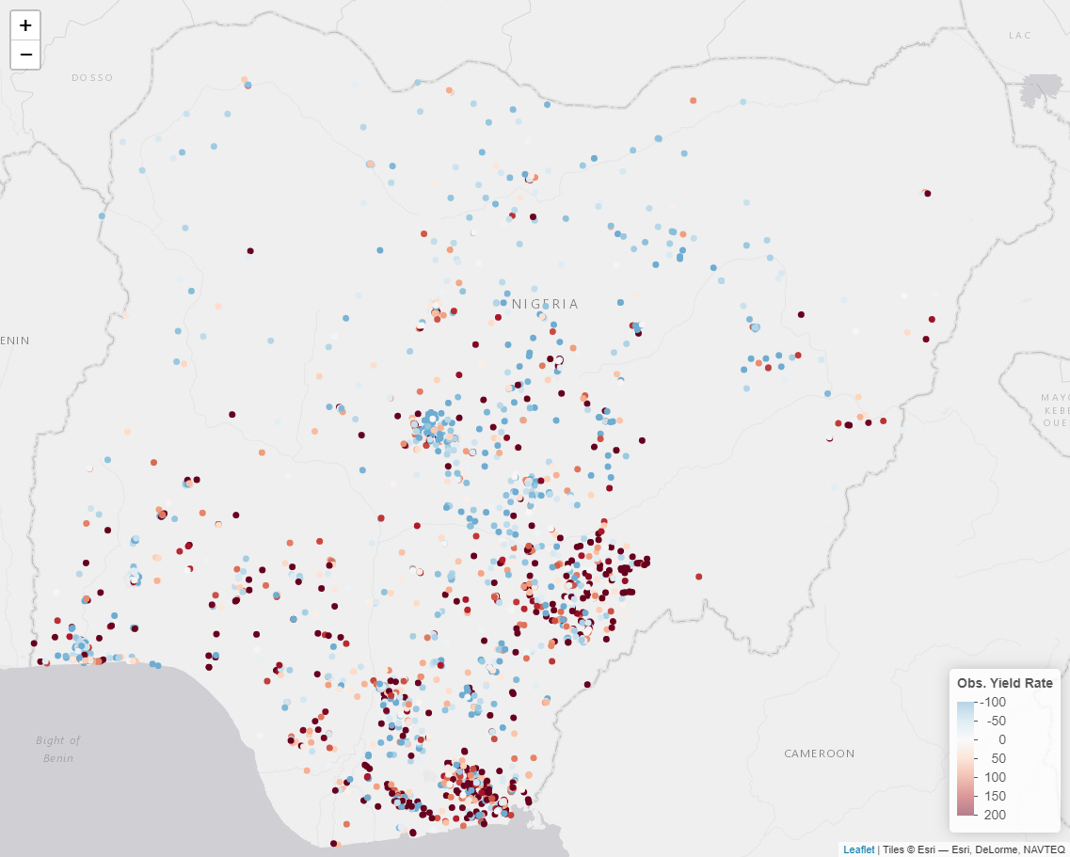
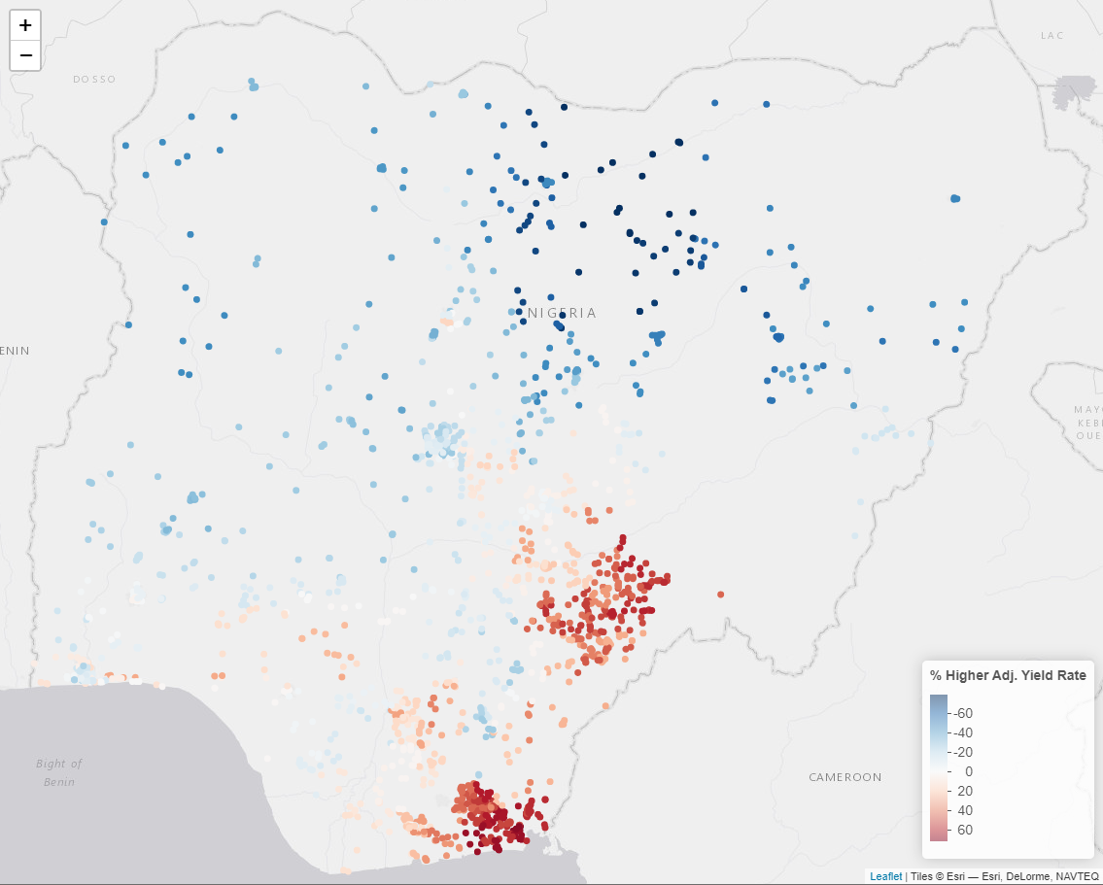
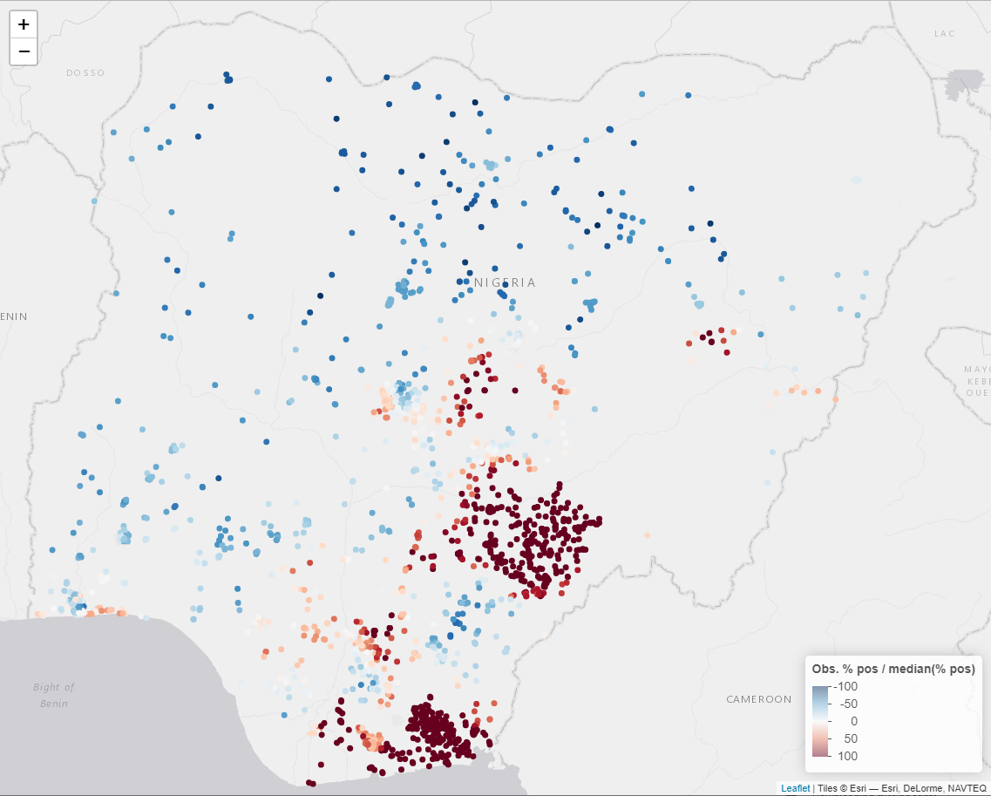
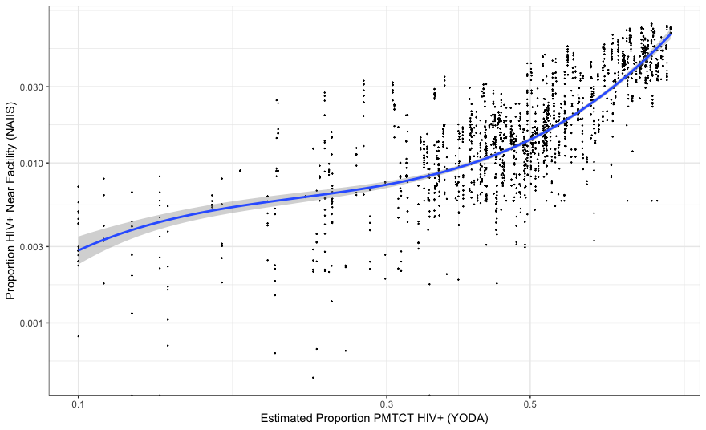
YODA: Smoothed Age Adjusted PMTCT Yield
Raw yield
YODA adj. yield
NAIIS HIV prevalence
Hierarchical clusters used for spatial smoothing.
Smoothed yield from 1.5 years ago used as a predictor in the YODA yield model.
ρ = 0.73

Slide 34
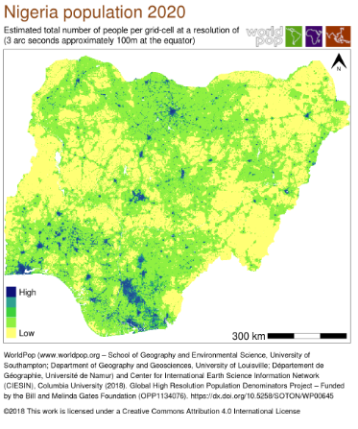
YODA: Local Population Sizes Using WorldPop
WorldPop provides raster files with population size at the pixel level.
For each site the population within 10km and 50km was computed.
These populations were used as YODA predictors.

Slide 35
Index Testing is Kind of Its Own Thing

Slide 36
YODA: Index Testing Revamp
Challenges:
The number of index tests done depends on the number of tests done in other modalities.
There is no way to “choose” the age/sex of people tested through index testing, with the possible exception of pediatric (i.e. test the children of new positives).
Solution:
Split the yield model into a model for non-index tests, and one for index tests given the number of non-index positives identified.
Alter optimization algorithm to optimize over non-index modalities with a user specified function for the ratio of index to non-index tests for a site given their ratio last quarter.

Slide 37
Thanks!
For more information, please contact:
Ian Fellows
ymx4@cdc.gov

Slide 38
Thanks!
Questions

